Slide 1

Compounding
World Expo
2019
NSG’s FLEKA® –
A Granulated Glass Flake Offering No Trade-offs
Between Strength and Dimensional Stability
Thursday May 9, 2019
Liz Gershon
Dreytek, Inc.
N. A. Business Manager
Tel: 973-729-2355| Cell: 201-513-6310
www.dreytek.com

Slide 2
Outline
History of Glass Flake
What is FLEKA® ?
Why use FLEKA® ?
How is it used ?
NEW: Updated 3rd party performance data for compounded plastics
NEW: FLEKA® for PE and PP
METASHINE™ Effects Pigment
FLEKA® for Barrier Enhancement
May 9^{th,} 2019

Slide 3


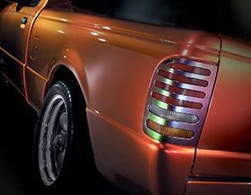



What Are Typical Applications for MicroGlas® Glass Flake?
Glass flake is used in industrial coatings due to its excellent fluid barrier properties
Glass flake is used in automotive coatings and cosmetics due to its pearlescence and glitter effects
Glass flake is used in plastics due to its isotropic dimensional stability effects
Glass flakes can vary in size:
  <.7um -5um in thickness
  30um-600um in avg diameter
But by themselves they are too small to handle in a compounding operation
May 9^{th,} 2019

Slide 4
What is FLEKA?
To enable easy handling of Microglas® glass flakes in a compounding operation, NSG adds a binder to the glass flakes, producing FLEKA® granules
  1 mm diameter granule of bonded glass flakes
  Individual flakes will separate when processed
  Glass flake dimensions are maintained during compounding because glass flakes are extremely tough and robust, made from Borosilicate glass
A sizing is applied to each glass flake, and various sizings are available
  Amino silane, epoxy silane, acryl silane, custom silanes
May 9^{th,} 2019

Slide 5
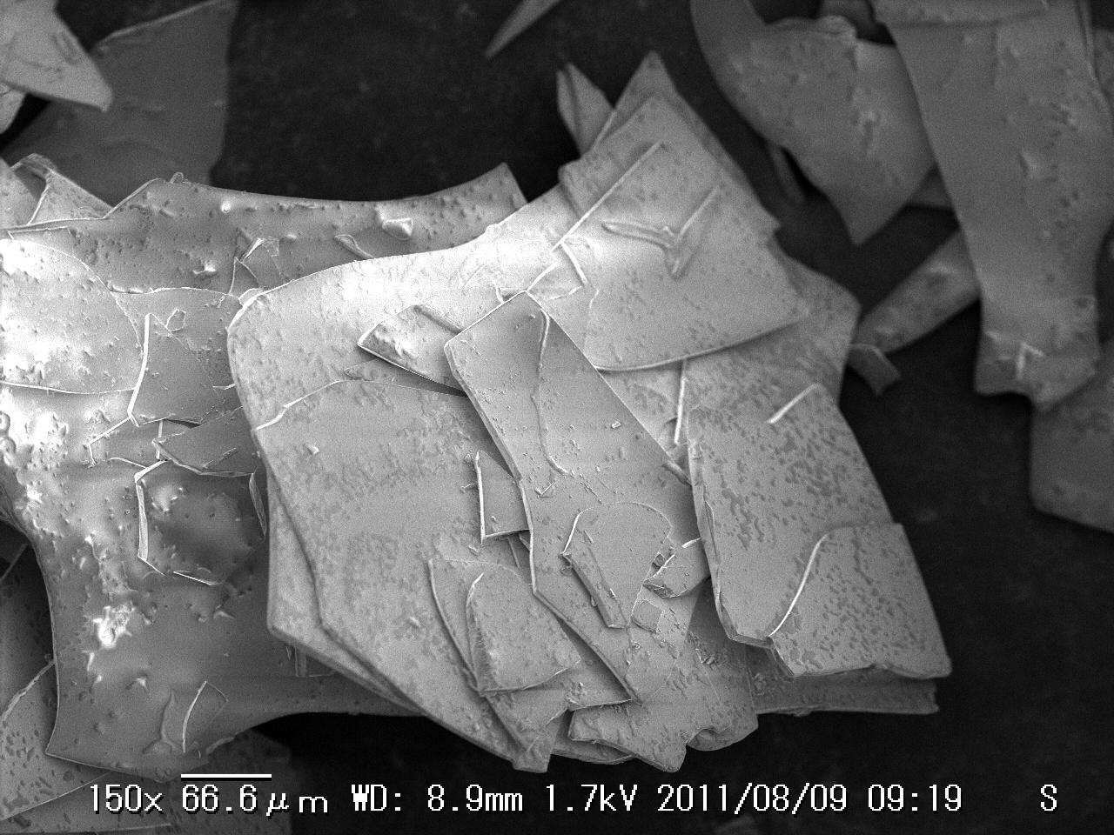
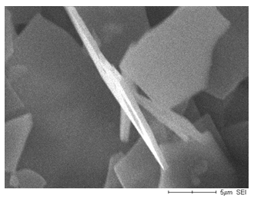
What is FLEKA?
FLEKA GRANULES (1mm) as they enter the extruder
Individualized GLASS FLAKES as they are compounded with the polymer
May 9^{th,} 2019

Slide 6
Why Use Glass Flakes and FLEKA ?
At 10% to 30% loading, FLEKA enhances the performance of the base polymer
  Mechanical Properties
    Improved dimensional stability, warpage, shrinkage, impact, wear, abrasion resistance (Isotropic, random orientation) compared to glass fiber
    Minimal loss in physical properties compared to mica and glass beads
  Decorative (METASHINE ® Effects Pigment)
    Aesthetic, visual effect, glitter, shimmer
    Color
    Heat Management
    Conductivity
    Identification
  Barrier Properties
    Reduced permeation to liquids and gas
    Corrosion protection over large pH and / or temperature range
May 9^{th,} 2019

Slide 7
Chopped Glass Fiber
Glass fiber reinforced thermoplastics
Fiber
Reinforcement occurs mostly in the flow/machine direction (MD)
Differential shrinkage occurs between the machine direction and the transverse direction, resulting in part warpage
May 9^{th,} 2019

Slide 8
FLEKA Glass Flake
Glass flake reinforced thermoplastics
Flake
Reinforcement is evenly distributed between the transverse direction (TD) and machine direction (MD)
Warpage is reduced, overall shrinkage is reduced
Dimensional stability is improved
May 9^{th,} 2019

Slide 9
Many Additives Are Available But Most Involve Performance Trade Offs
Additive | Mechanical Properties | Dimensional Stability
Glass Fiber | ✔✔ | −
Mica | − | ✔
Glass Bead | − | ✔
FLEKA® Glass Flake | ✔ | ✔✔
FLEKA® offers almost no trade off between strength and warpage/shrinkage
It will never replace all glass fiber used
FLEKA® is another tool in your tool box
May 9^{th,} 2019

Slide 10
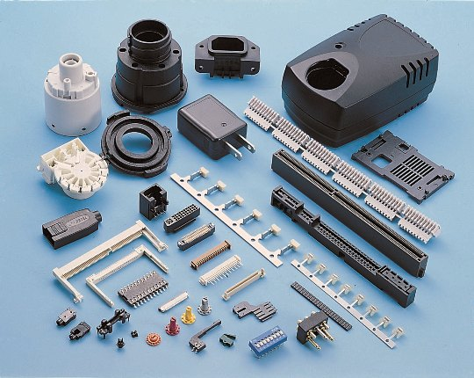
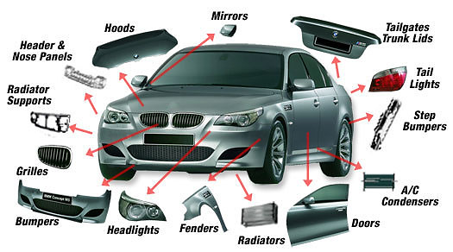
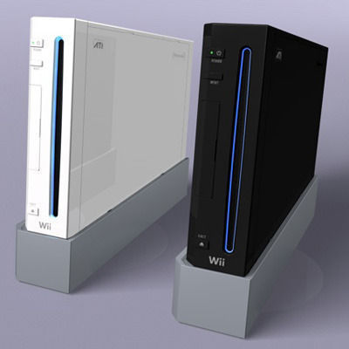
FLEKA® - Applications
Electronic parts
Automotive Applications
Game instruments
May 9^{th,} 2019

Slide 11
What Data Demonstrates This Performance?
In early 2019, a DOE was completed by Interfacial Consultants (https://ifllc.com) to compare physical properties in natural PBT:
  Materials
    FLEKA Glass Flake
    Glass Fiber
    Mica
    Glass Spheres
  Properties Measured
    Shrinkage (MD, TD)
    Warpage
    Tensile properties
    Flexural properties
    Impact
    Weld line properties
    HDT
    Flow
  Various Formulations
    90% PBT/10% Additive
    70% PBT/30% Additive
    70% PBT/20% Glass Fiber/10% FLEKA or Mica or Glass Spheres
More data from the DOE is in the Appendix of this presentation
May 9^{th,} 2019

Slide 12

Formulations
Sample | PBT | FLEKA REFG-101 | FINEFLAKE MEG160FY-M01 | Mica WG325 | Spheriglass 1922 w/ CP-02 Coating | ThermoFlow 600+
1 | 100
2 | 90 | 10
3 | 70 | 30
4 | 90 |  | 10
5 | 70 |  | 30
6 | 90 |  |  | 10
7 | 70 |  |  | 30
8 | 90 |  |  |  | 10
9 | 70 |  |  |  | 30
10 | 90 |  |  |  |  | 10
11 | 70 |  |  |  |  | 30
12 | 70 | 10 |  |  |  | 20
13 | 70 |  | 10 |  |  | 20
14 | 70 |  |  | 10 |  | 20
15 | 70 |  |  |  | 10 | 20
PBT / FLEKA compounds are clearly a formulation option (#3)
Commercial formulations will most likely involve glass fiber/FLEKA combinations (#12)
HELPING INNOVATORS INCUBATE
12

Slide 13
Mold Shrinkage/Warpage (astm D955)
Sample # | Compound | Pre-Annealed Transverse Direction Shrinkage (TD) (%) | Pre-Annealed Machine Direction Shrinkage (MD) (%) | Warpage (TD%-MD%)
#1 | 100% PBT | 1.42+/- 0.02 | 2.09 +/- 0.41 | .67
#3 | 70% PBT/30% FLEKA | 0.03 +/- 0.01 | 0.39 +/- 0.09 | .36
#11 | 70% PBT/30% Glass Fiber | 0.94 +/- 0.02 | 0.02 +/-0.02 | .92
#12 | 70% PBT/20% GF/10% FLEKA | 0.55 +/-0.02 | 0.03 +/- 0.03 | .52
#14 | 70% PBT/20% GF/10% Mica | 0.73 +/- 0.01 | 0.19 +/- 0.09 | .54
#15 | 70% PBT/20% GF/10% Glass Bead | 0.92 +/- 0.01 | 0.10 +/- 0.02 | .82
HELPING INNOVATORS INCUBATE

Slide 14
Tensile Properties (astm D638)
Sample # | Compound | Tensile Strength (psi) | Elongation At Break (%) | Tensile Modulus (psi)
#1 | 100% PBT | 7,800 +/- 280 | 12.2 +/- 0.7 | 348,800 +/- 6200
#3 | 70% PBT/30% FLEKA | 13,030 +/- 180 | 2.2 +/- 0.1 | 1,284,200 +/- 20,300
#11 | 70% PBT/30% Glass Fiber | 17,300 +/- 240 | 2.5 +/- 0.1 | 1,329,300 +/- 14,300
#12 | 70% PBT/20% GF/10% FLEKA | 16,930 +/- 40 | 2.5 +/- 0.1 | 1,385,400 +/- 13,500
#14 | 70% PBT/20% GF/10% Mica | 14,420 +/- 180 | 2.4 +/- 0.1 | 1,290,800 +/- 21,100
#15 | 70% PBT/20% GF/10% Glass Bead | 14,470 +/- 120 | 2.7 +/- 0.1 | 1,079,300 +/- 12,300
HELPING INNOVATORS INCUBATE

Slide 15
Performance Comparison Of Additives for plastic
Note: Data was normalized for the graph

Slide 16
Another Glass Flake Option for Improved Weld Line Strength: NSG FineFlake™
NSG also offers .7um thick, 160um avg diameter, glass flake, FineFlake™
It offers the highest Weld Line Tensile Strength of all products tested
Come visit us at Booth A423 to learn more about FineFlake™
Note: Data was normalized for the graph

Slide 17
Weld Line Properties (astm D638)
Sample # | Compound | Tensile Strength (psi) | Elongation At Break (%) | Tensile Modulus (psi)
#1 | 100% PBT | 170 +/- 80 |  | 15,900+/11840
#3 | 70% PBT/30% FLEKA | 230 +/- 170 | 0.8 +/- 0.2 | 50,670 +/- 9,060
#11 | 70% PBT/30% Glass Fiber | 250 +/- 60 | 0.5 +/- 0.1 | 54,790 +/- 1,110
#12 | 70% PBT/20% GF/10% FLEKA | 350 +/- 60 | 0.7 +/- 0.1 | 56,930 +/- 2,180
#13 | 70% PBT/30% FineFlake | 600 +/- 40 | 1.3 +/- 0.2 | 65,460 +/- 2,153
#14 | 70% PBT/20% GF/10% Mica | 280 +/- 100 | 0.8 +/- 0.2 | 42,470 +/- 7,250
#15 | 70% PBT/20% GF/10% Glass Bead | 410 +/- 30 | 1.0 +/- 0.1 | 46,820 +/- 3,240
HELPING INNOVATORS INCUBATE

Slide 18
New FINEFLAKE™ For Polyolefins
Patent Application US 2018/0155534 A1 (November 2018)
Polypropylene and polyethylene are more challenging resins for glass flake-to-polymer coupling
NSG invented a new grade, FINEFLAKE MEG160FY-M04 :
  A new sizing specifically for PP and PE
  A new binder specifically for PP and PE
  A new crosslinking agent and catalyst for PP and PE
All components are balanced for performance and ease of dispersion
December 5th, 2018

Slide 19
Performance Comparison Of Additives for plastic
PBT/Glass Fiber/FLEKA offers lower shrinkage and warpage compared to PBT/glass fiber compounds with very minimal decrease in strength properties
PBT/Glass Fiber/FLEKA offers lower shrinkage and warpage compared to PBT/glass fiber/mica and PBT/glass fiber/glass bead compounds with improved mechanical properties
FLEKA, most likely in combination with glass fiber, offers the best balance of properties between warpage and mechanical properties – NO TRADE-OFF
FineFlake offers the best weld line performance of all formulations
FLEKA and FINEFLAKE are additional tools in the tool box
But optimized formulations are application and design dependent, and require the expertise of product developers

Slide 20
Why Use Glass Flakes and FLEKA ?
At 10% to 30% loading, FLEKA enhances the performance of the base polymer
  Mechanical Properties
    Improved dimensional stability, warpage, shrinkage, impact, wear, abrasion resistance (Isotropic, random orientation) compared to glass fiber
    Minimal loss in physical properties compared to mica and glass beads
  Decorative (METASHINE ® Effects Pigment)
    Aesthetic, visual effect, glitter, shimmer
    Color
    Heat Management
    Conductivity
    Identification
  Barrier Properties
    Reduced permeation to liquids and gas
    Corrosion protection over large pH and / or temperature range
May 9^{th,} 2019

Slide 21

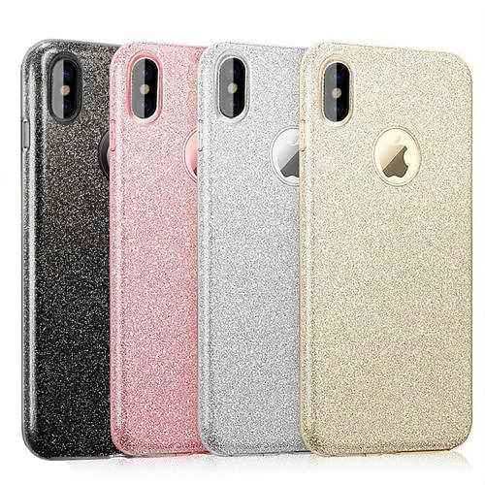
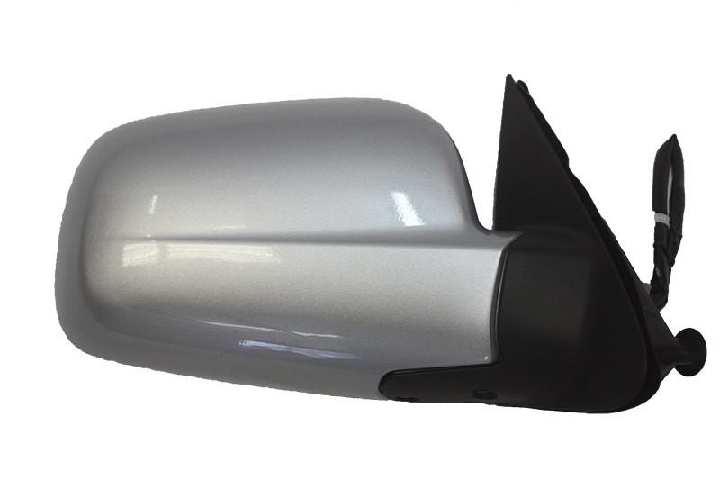
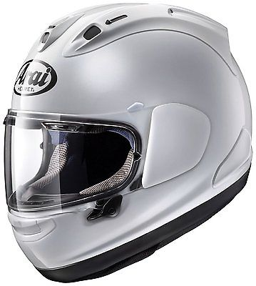
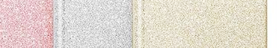
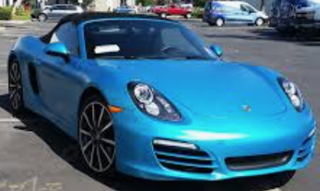

METASHINE® Effects Pigments
Produced from NSG glass flake substrates
Coated with a variety of NSG proprietary surface treatments for glitter and sparkle effects
Dozens of color + particle size combinations are commercially available
December 5th, 2018

Slide 22
Why Use Glass Flakes and FLEKA ?
At 10% to 30% loading, FLEKA enhances the performance of the base polymer
  Mechanical Properties
    Improved dimensional stability, warpage, shrinkage, impact, wear, abrasion resistance (Isotropic, random orientation) compared to glass fiber
    Minimal loss in physical properties compared to mica and glass beads
  Decorative (METASHINE ® Effects Pigment)
    Aesthetic, visual effect, glitter, shimmer
    Color
    Heat Management
    Conductivity
    Identification
  Barrier Properties
    Reduced permeation to liquids and gas
    Corrosion protection over large pH and / or temperature range
May 9^{th,} 2019

Slide 23
Glass Flakes Act As A Highly Tortuous Barrier
(Cross Sectional View)
Without Glass Flakes
With Glass Flakes
Corrosive
Fluid
Plastic
Reduced permeation rate
December 5th, 2018

Slide 24
Summary
FLEKA ® and FINEFLAKE ™
Inert glass-based flake compounding additive used for plastic reinforcement
  Excellent balance of dimensional stability and physical properties, when formulated with Glass Fiber – NO TRADE-OFF!
  Easy to process: a granulated product
  New innovative surface treatment for glass flakes used with PP and PE
FLEKA for Barrier Performance
  Excellent acid resistance
  Provides tortuous barrier to reduce permeation rate of liquids and gases
METASHINE effects pigments
  High efficiency glitter and color
  Inert material
  Highly dispersible
Once qualified, no-charge samples can be ordered directly from Dreytek
Come See Us at Booth A423
December 5th, 2018

Slide 25


Your Questions ?
Please Visit Our Booth A423
December 5th, 2018

Slide 26
Appendix
December 5th, 2018

Slide 27
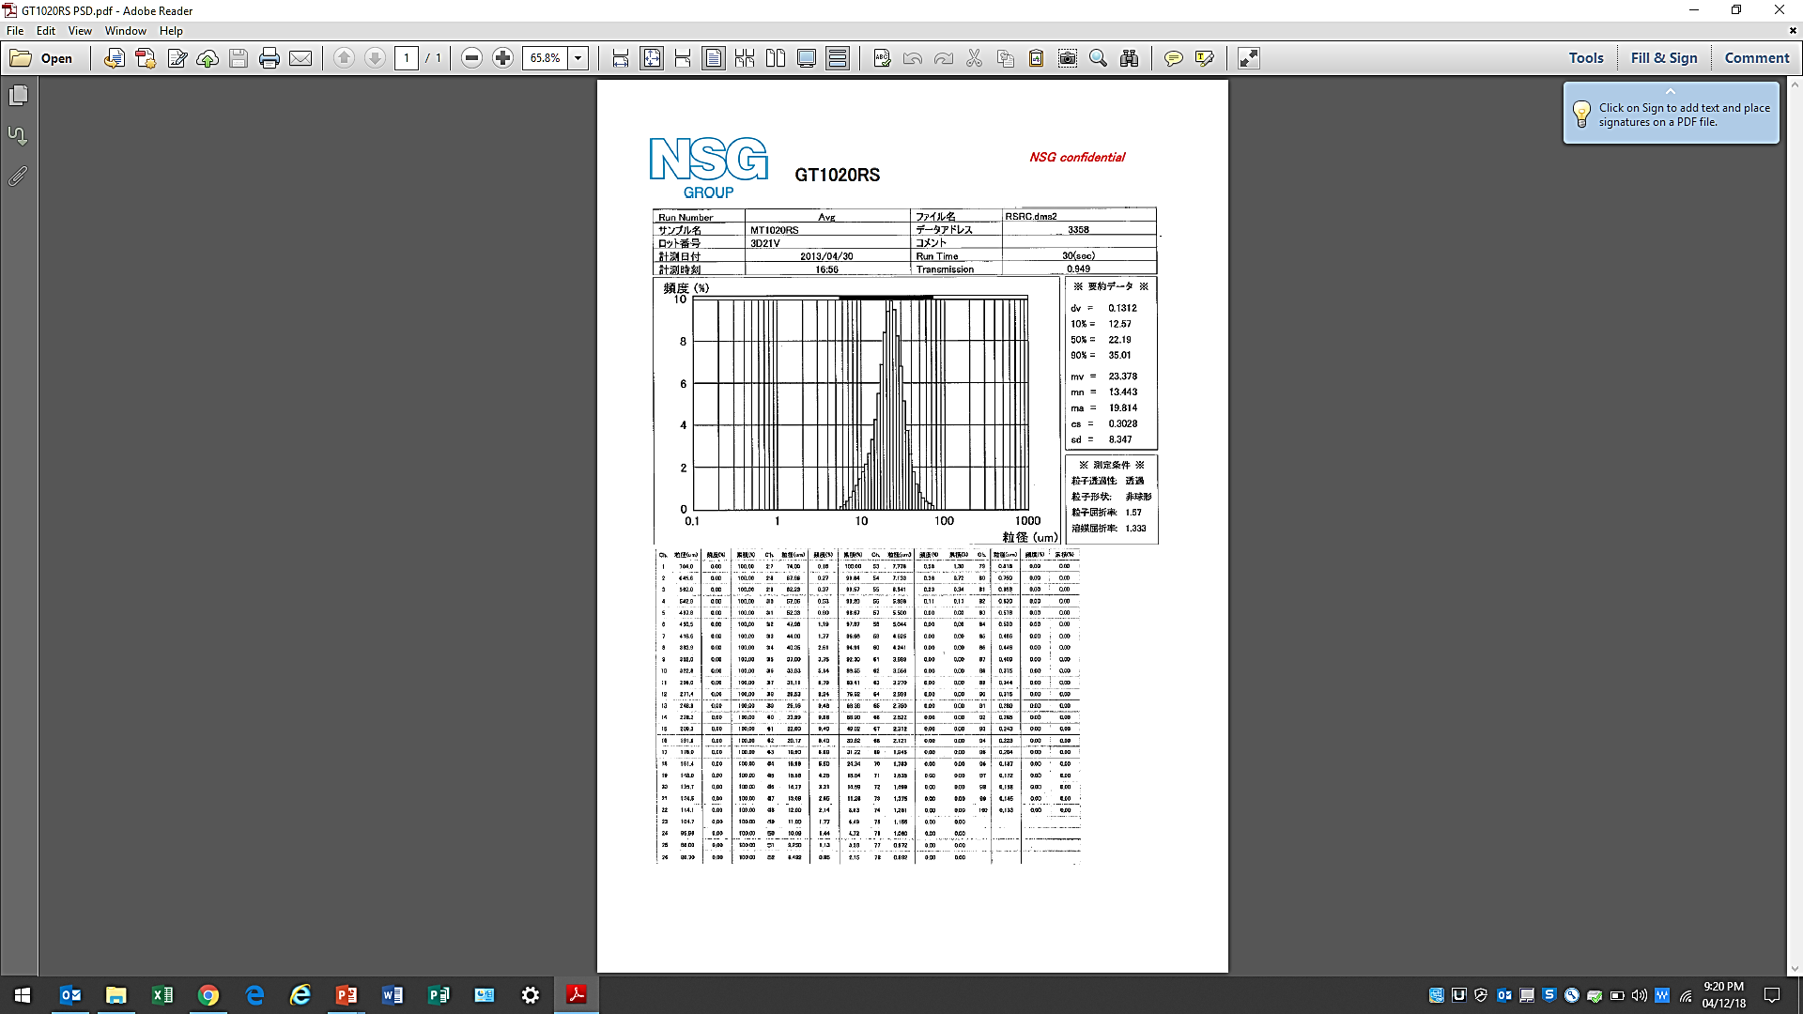
What Are Typical Glass Flake Particle Size Distribution (PSD) and Measurement Systems?
Glass flake PSD requirements in customer applications is often critical for performance
NSG controls PSD to very tight tolerances
Many measurement systems assume spherical or regular shaped particles
NSG’s measuring technology was developed to manage irregularly shaped flakes
May 9^{th,} 2019

Slide 28
Materials
Polybutylene terephthalate (PBT)
  Supplied by IFC
  Celanex Thermoplastic Polyester
Glass Flake
  Supplied by Dreytek
  Two sizes: REFG-101, MEG160FY-M01
Mica
  Supplied by IFC
  Standard grade: Imerys WG325 (34 micron)
Glass spheres
  Supplied by IFC
  Standard grade: Potters Spheriglass 1922 w/CP-02 coating (~200 micron)
Glass Fiber
  Supplied by IFC
  Standard grade: ThermoFlow 600+ (4 mm and 10 micron)
HELPING INNOVATORS INCUBATE
28

Slide 29
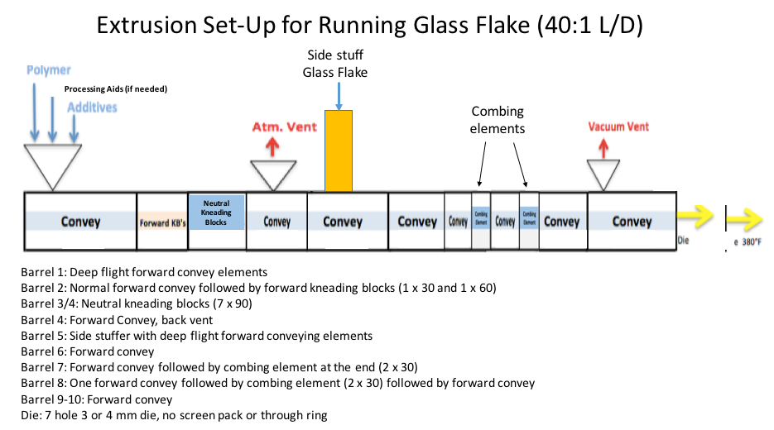
Extrusion Set-Up for Running Glass Flake (40:1 L/D)

Slide 30
Flexural Properties (astm D638)
Sample # | Compound | Flexural Strength (psi) | Flexural Modulus (psi)
#1 | 100% PBT | 12,070 +/- 290 | 346,600 +/- 7,300
#3 | 70% PBT/30% FLEKA | 20,190 +/- 150 | 1,078,500 +/- 9,700
#11 | 70% PBT/30% Glass Fiber | 26,260 +/- 490 | 1,143,500 +/- 29,100
#12 | 70% PBT/20% GF/10% FLEKA | 24,930 +/- 350 | 1,122,400 +/- 32,000
#14 | 70% PBT/20% GF/10% Mica | 21,710 +/- 180 | 1,079,500 +/- 27,000
#15 | 70% PBT/20% GF/10% Glass Bead | 22,400 +/- 140 | 919,000 +/- 10,400
HELPING INNOVATORS INCUBATE

Slide 31
Impact (astm D256)
Sample # | Compound | UnNotched Izod (ft-lb/in) | Notched Izod (ft-lb/in)
#1 | 100% PBT | > 16 | 0.45 +/- 0.01
#3 | 70% PBT/30% FLEKA | 8.52 +/- 0.41 | 0.57 +/- 0.02
#11 | 70% PBT/30% Glass Fiber | 11.6 +/- 0.39 | 1.4 +/- 0.10
#12 | 70% PBT/20% GF/10% FLEKA | 10.5 +/- 0.53 | 1.2 +/- 0.07
#14 | 70% PBT/20% GF/10% Mica | 9.21 +/- 0.26 | 1.0 +/- 0.07
#15 | 70% PBT/20% GF/10% Glass Bead | 10.0 +/- 0.50 | 1.1 +/- 0.04
HELPING INNOVATORS INCUBATE

Slide 32
Heat Deflection Temperature (astm D648)
Sample # | Compound | 0.45 MPa (ºC) | 1.8 MPa (ºC)
#1 | 100% PBT | 108.4 +/- 6.2 | 47.6 +/- 1.1
#3 | 70% PBT/30% FLEKA | 190.6 +/- 10.7 | 150.1 +/- 10.5
#11 | 70% PBT/30% Glass Fiber | >200 | 196.4 +/- 6.0
#12 | 70% PBT/20% GF/10% FLEKA | >200 | 188.8 +/- 0.4
#14 | 70% PBT/20% GF/10% Mica | >200 | 180.3 +/- 4.2
#15 | 70% PBT/20% GF/10% Glass Bead | >200 | 196.1 +/- 7.6
HELPING INNOVATORS INCUBATE

Slide 33
Shear Rate Viscosity
Sample # | Compound | Low shear (30 1/s) | High Shear (5000 1/s)
#1 | 100% PBT | 226 | 86
#3 | 70% PBT/30% FLEKA | 384 | 111
#11 | 70% PBT/30% Glass Fiber | 535 | 104
#12 | 70% PBT/20% GF/10% FLEKA | 577 | 100
#13 | 70% PBT/20% GF/10% FineFlake | 603 | 110
#14 | 70% PBT/20% GF/10% Mica | 487 | 107
#15 | 70% PBT/20% GF/10% Glass Bead | 506 | 113
HELPING INNOVATORS INCUBATE

Slide 34
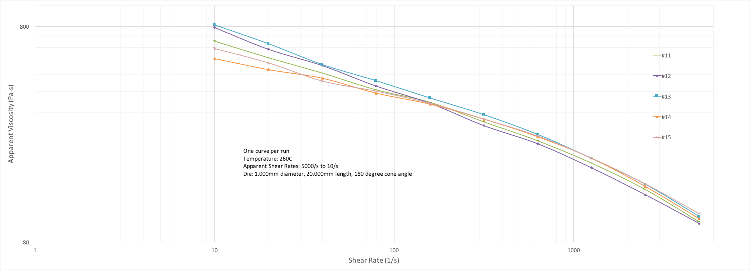
Rheology Curves (Samples 11,12,13,14,15)

